Slide 1

Will be my family? 202455423 DabinBaek
Website for adopting abandoned pets in Busan

Slide 2
Data collecting
I collected real stray animal data from the official Korean government site:www.animal.go.kr
From the nationwide list,I filtered only the animals located in Busan.
Due to access restrictions, I could not use actual pet photos.Instead, we used free licensed images from Pixabay.

Slide 3
Data collecting
Image Sources by Poodlehttps://cdn.pixabay.com/photo/2021/02/06/06/29/dog-5987025_1280.jpghttps://cdn.pixabay.com/photo/2022/07/12/17/12/dog-7317820_1280.jpghttps://cdn.pixabay.com/photo/2024/12/06/05/16/dogs-9247872_1280.jpgMaltesehttps://cdn.pixabay.com/photo/2018/04/09/15/52/puppy-3304447_1280.jpghttps://cdn.pixabay.com/photo/2016/01/05/17/51/maltese-1123016_1280.jpghttps://cdn.pixabay.com/photo/2019/10/29/08/00/dog-4586317_1280.jpgGolden Retrieverhttps://cdn.pixabay.com/photo/2023/09/24/14/05/dog-8272860_1280.jpghttps://cdn.pixabay.com/photo/2015/08/06/10/40/puppy-877664_1280.jpghttps://cdn.pixabay.com/photo/2024/03/19/20/14/golden-retriever-puppies-8644050_1280.jpgMixed Breedhttps://cdn.pixabay.com/photo/2023/09/04/06/59/dog-8232158_1280.jpghttps://cdn.pixabay.com/photo/2018/12/19/19/46/dog-3884646_1280.jpghttps://cdn.pixabay.com/photo/2022/03/02/22/38/border-collie-7044172_1280.jpgChihuahuahttps://cdn.pixabay.com/photo/2014/09/19/21/47/chihuahua-453063_1280.jpghttps://cdn.pixabay.com/photo/2014/09/19/21/44/chihuahua-453059_1280.jpghttps://cdn.pixabay.com/photo/2015/11/17/12/42/puppy-1047454_1280.jpg

Slide 4
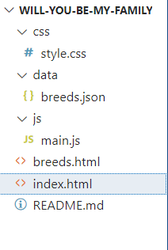
File order

Slide 5
style.css – Styling the Website
style.css – Overview
Defines the layout and appearance of the breed listing page.
Key Parts:
- .grid: responsive layout for pet cards
- .pet-card: rounded, shadowed cards with hover effect
- #search: rounded search bar with padding
- .filter: styled buttons; .active changes color
- .modal: dark overlay with centered white content box
:Adds clean, user-friendly styling for search, filter, and pet card display.

Slide 6
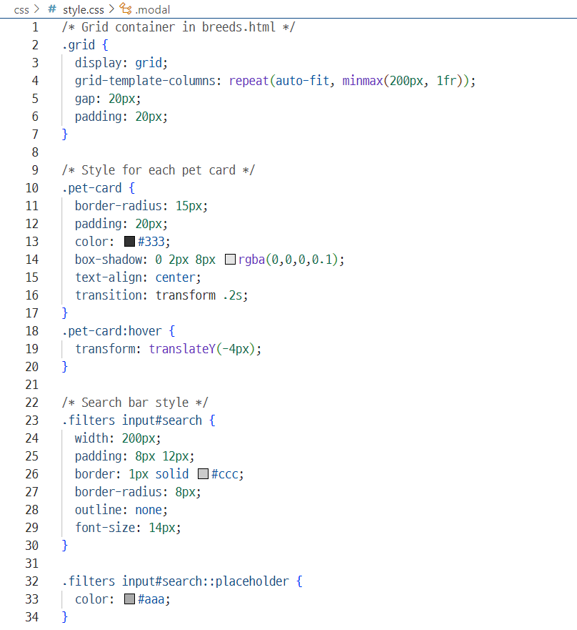
style.css – Code Snippet

Slide 7
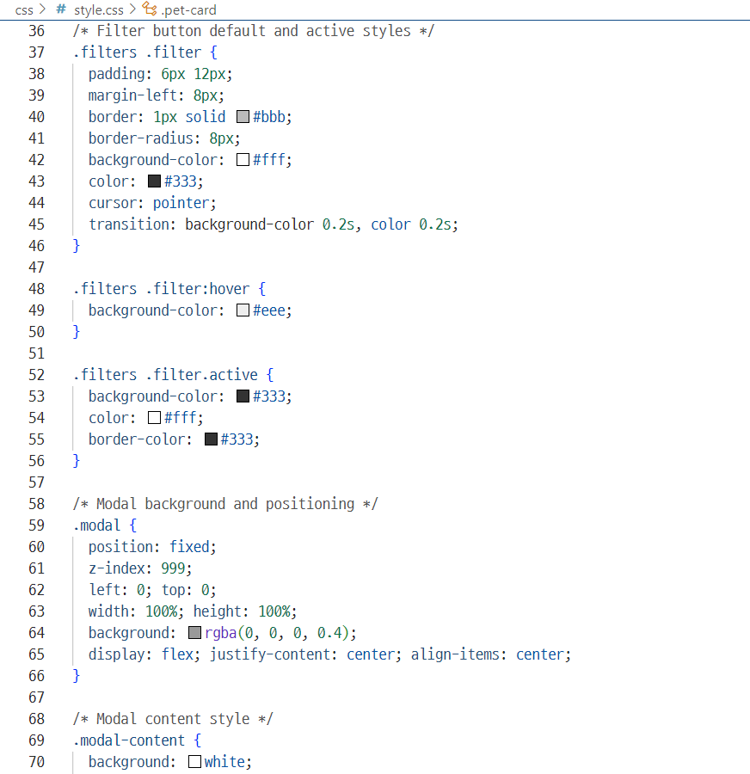
style.css – Code Snippet

Slide 8
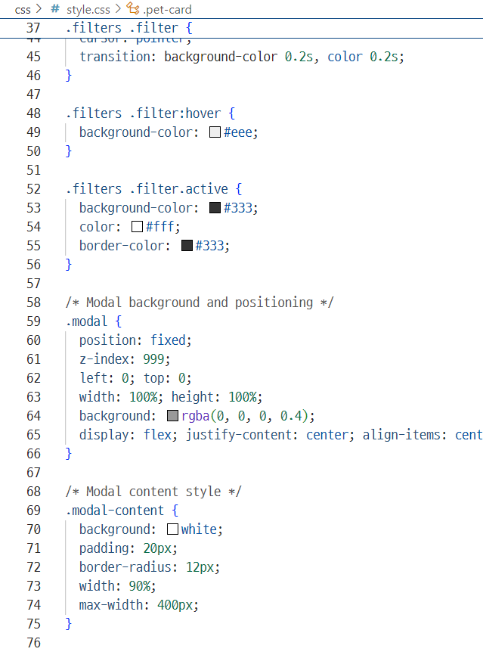
style.css – Code Snippet

Slide 9
breeds.json
breeds.json file is a structured dataset that stores information about adoptable pets. Each entry includes details such as:
name: the breed or type of the animal
type: Dog or Cat
size: Small, Medium, or Large
personality: a brief personality trait
available: adoption availability (true/false)
image: a URL to a representative image
note: special observations or health notes
description: rescue location and background
This file allows the website to dynamically display and filter pet listings using JavaScript.

Slide 10
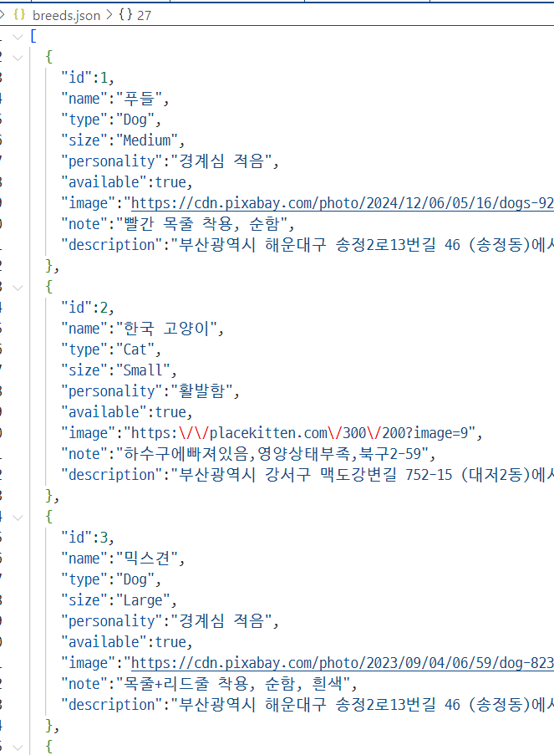
breeds.json – Code Snippet

Slide 11
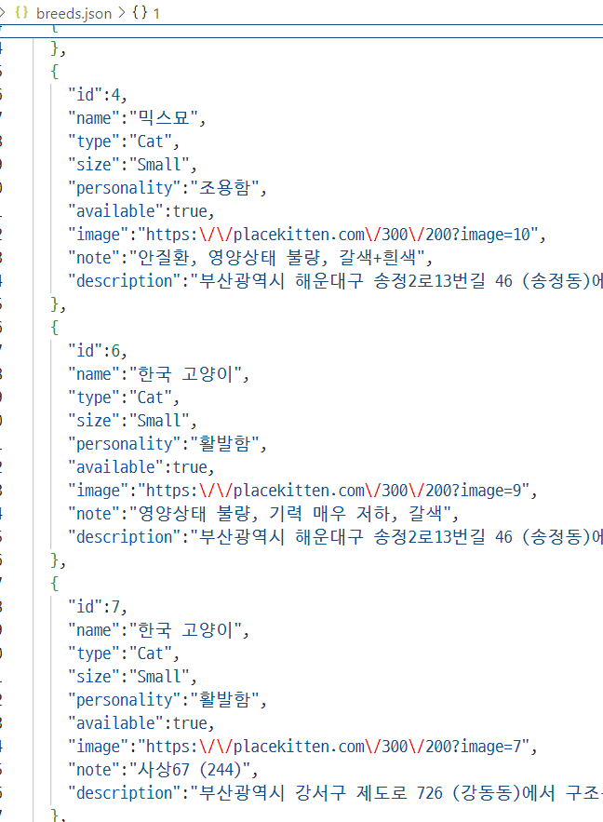
breeds.json – Code Snippet

Slide 12
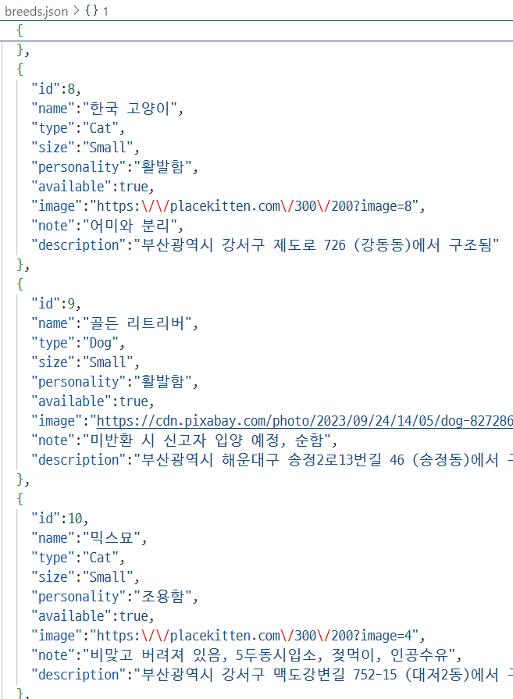
breeds.json – Code Snippet

Slide 13
main.js
OverviewLoads pet data, applies filters, and updates the display.
Key Features:
Fetches data from breeds.json on load-
Filters by type (from URL), name (search), and availability
Adds event listeners for search and filter buttons
Functions:
-applyFilters(): filters pets and calls renderCards()
-renderCards(): creates styled cards for each pet
:Handles search and filter logic to display matching pet cards dynamically.

Slide 14
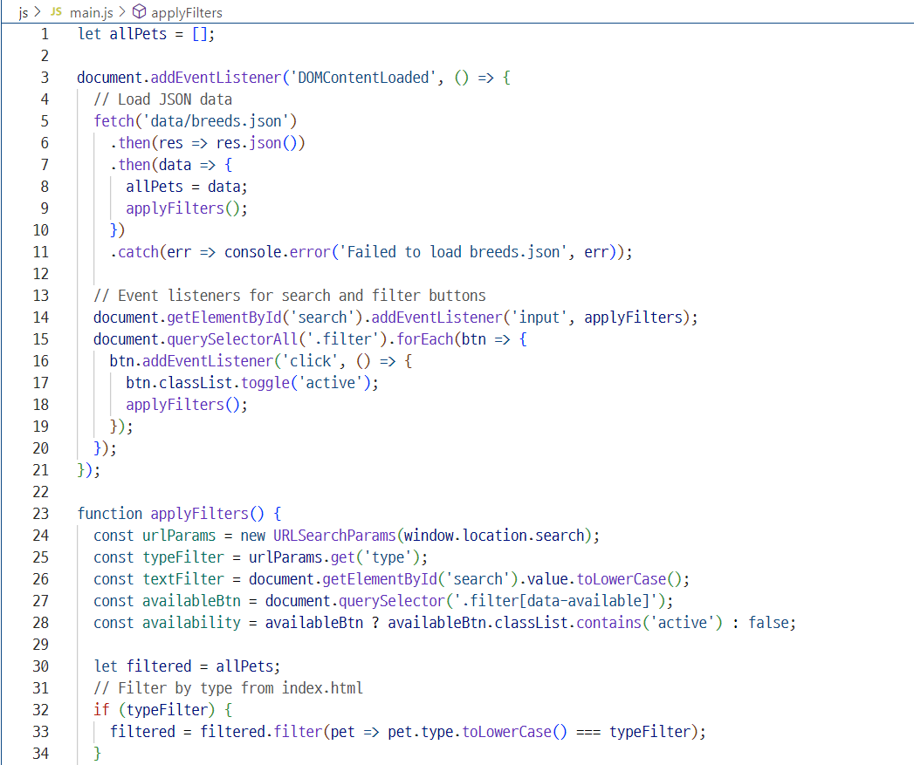
main.js– Code Snippet

Slide 15
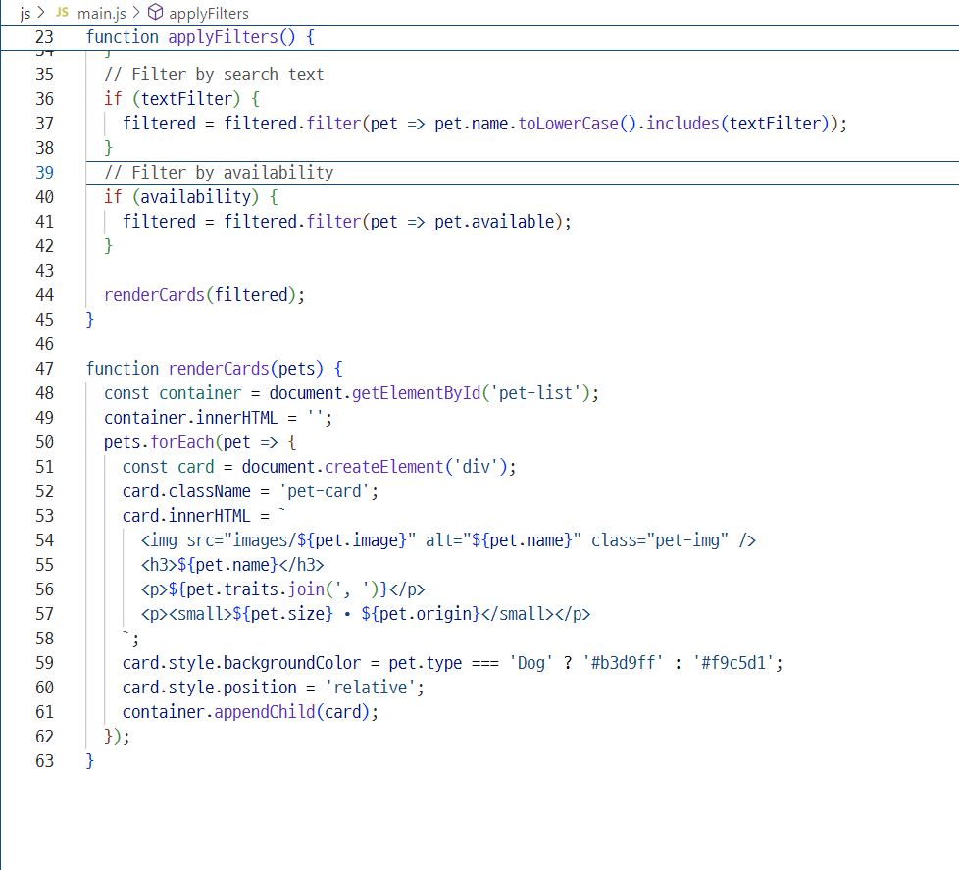
main.js– Code Snippet

Slide 16
breeds.html
This page displays adoptable pets with search, filter, and favorite features. Main pet listing page with interactive filters and multilingual support.
Structure:
- <head>: style.css, Google Fonts, inline styles
- <body>: search bar, filter buttons, pet card grid, modal, translate widget
Key Features:
- Loads data from breeds.json
- Filters by type, name, personality, availability, and breed
- Favorites saved with heart icon (localStorage)
- Modal shows pet details
- Supports multiple languages via Google Translate

Slide 17
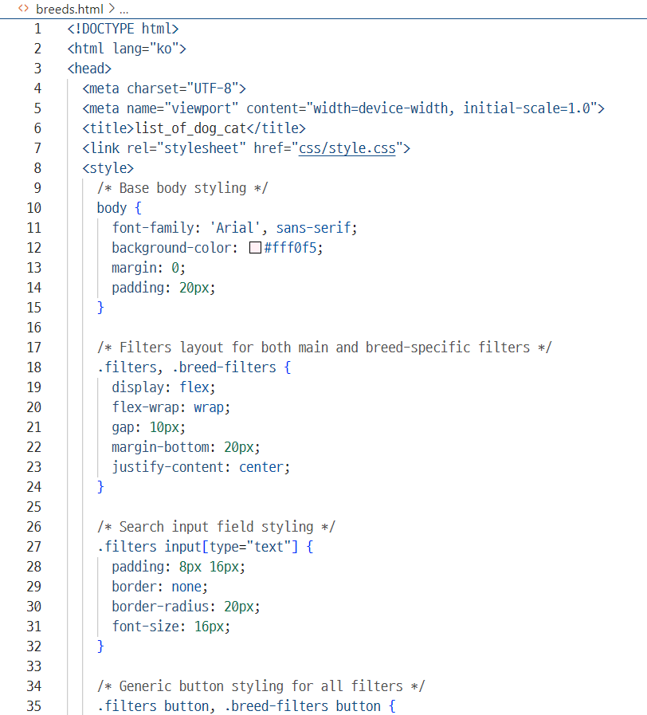
breeds.html– Code Snippet

Slide 18
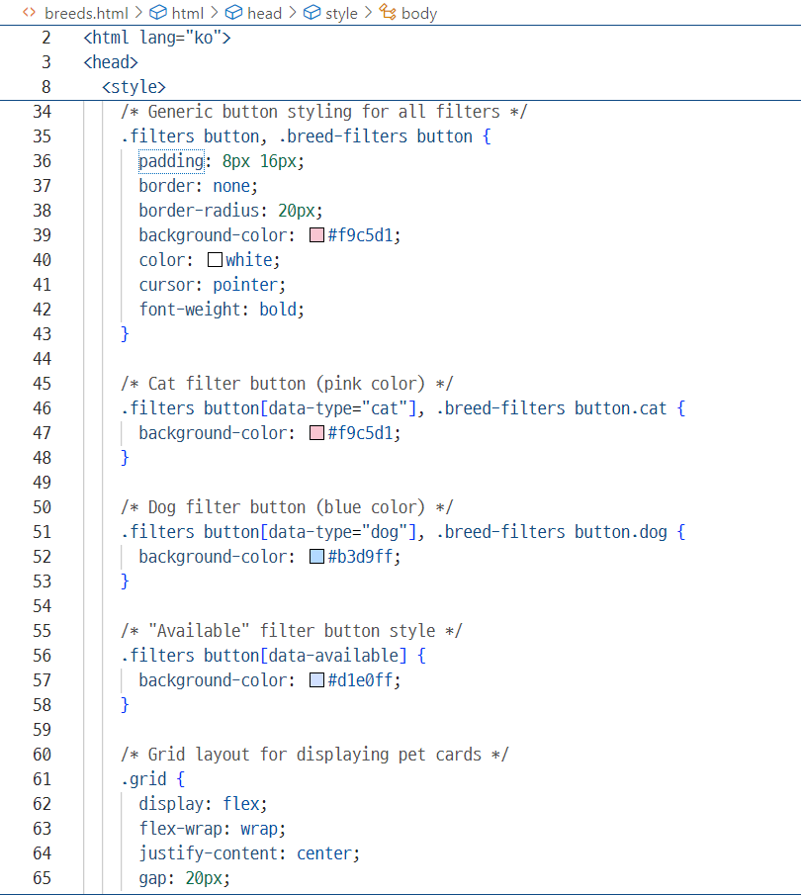
breeds.html– Code Snippet

Slide 19
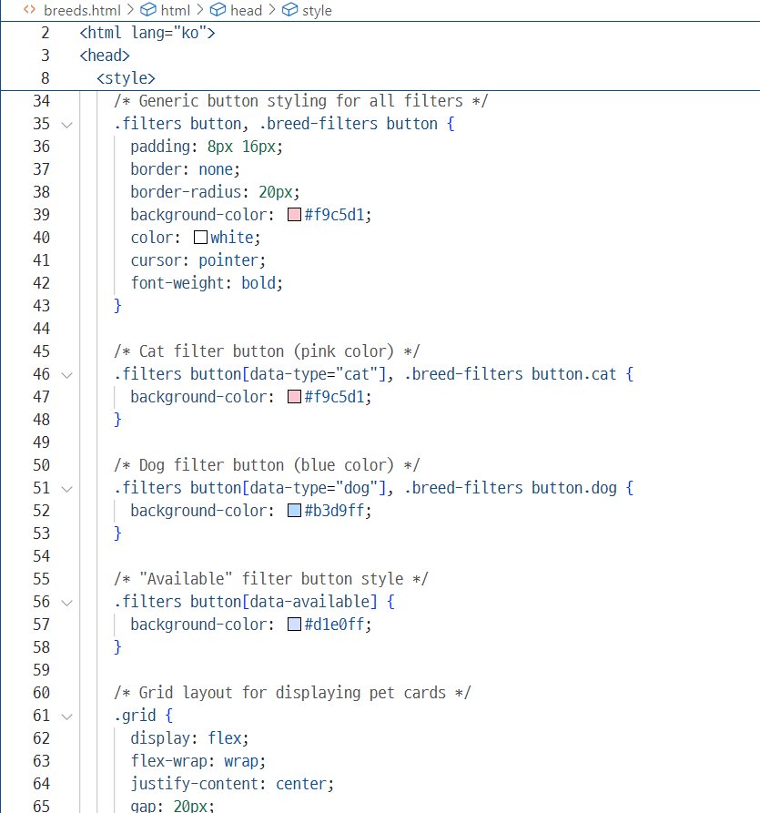
breeds.html– Code Snippet

Slide 20
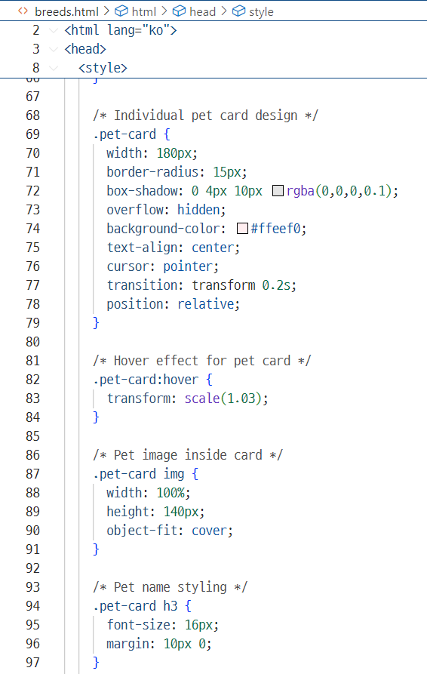
breeds.html– Code Snippet

Slide 21
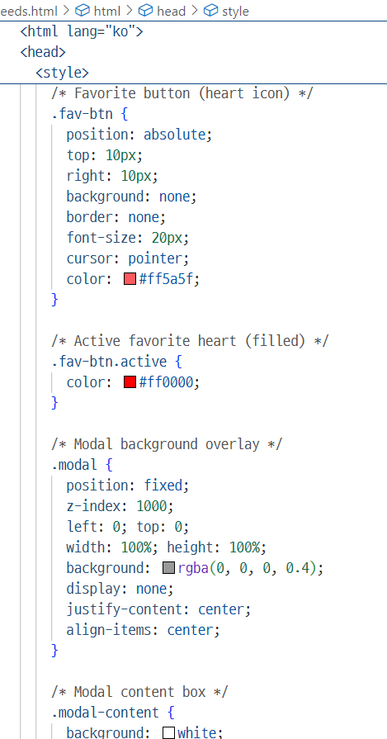
breeds.html– Code Snippet

Slide 22
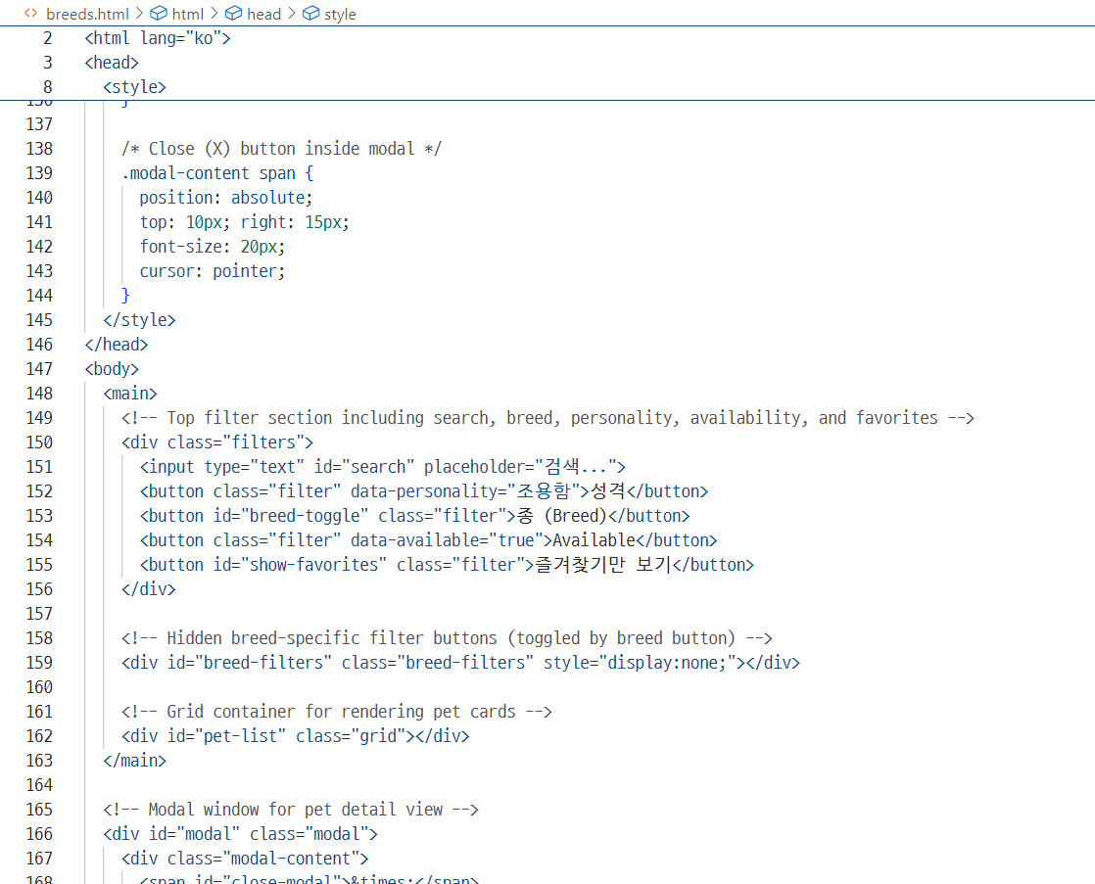
breeds.html– Code Snippet

Slide 23
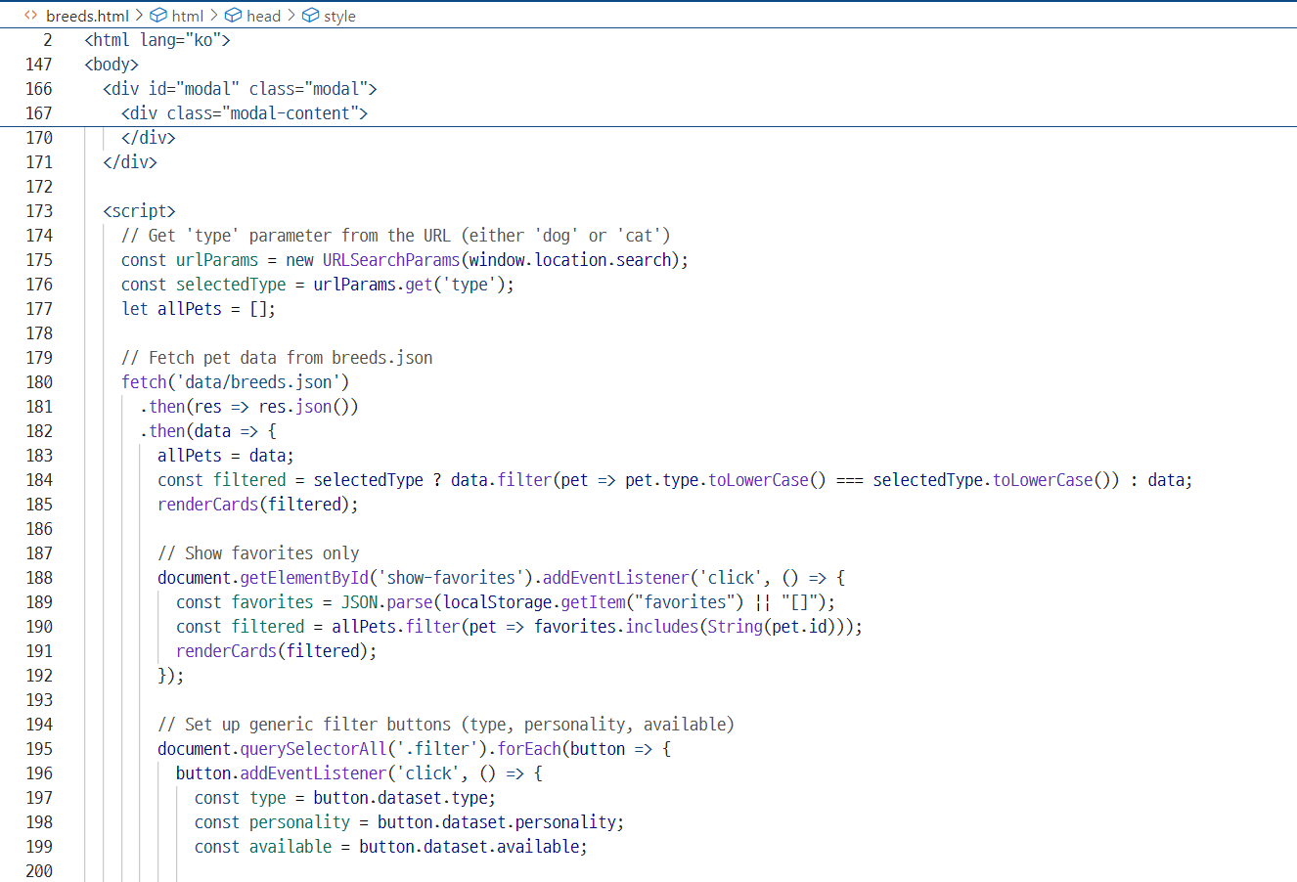
breeds.html– Code Snippet

Slide 24
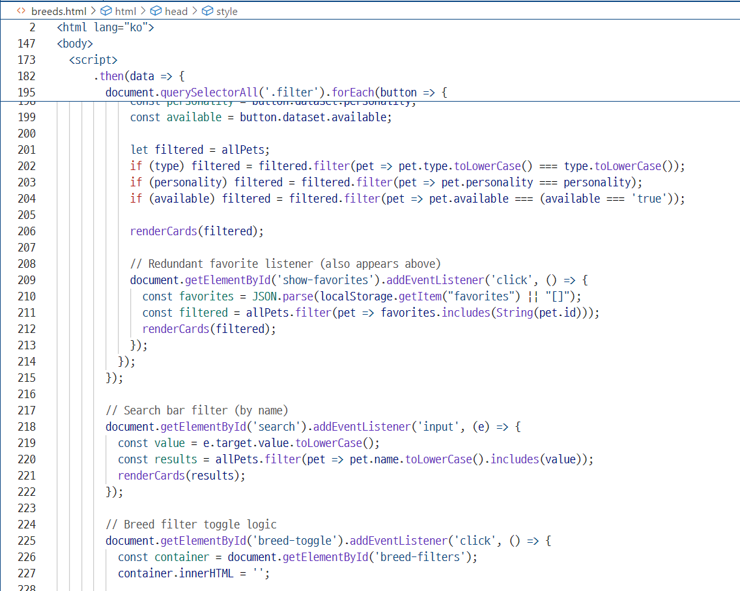
breeds.html– Code Snippet

Slide 25
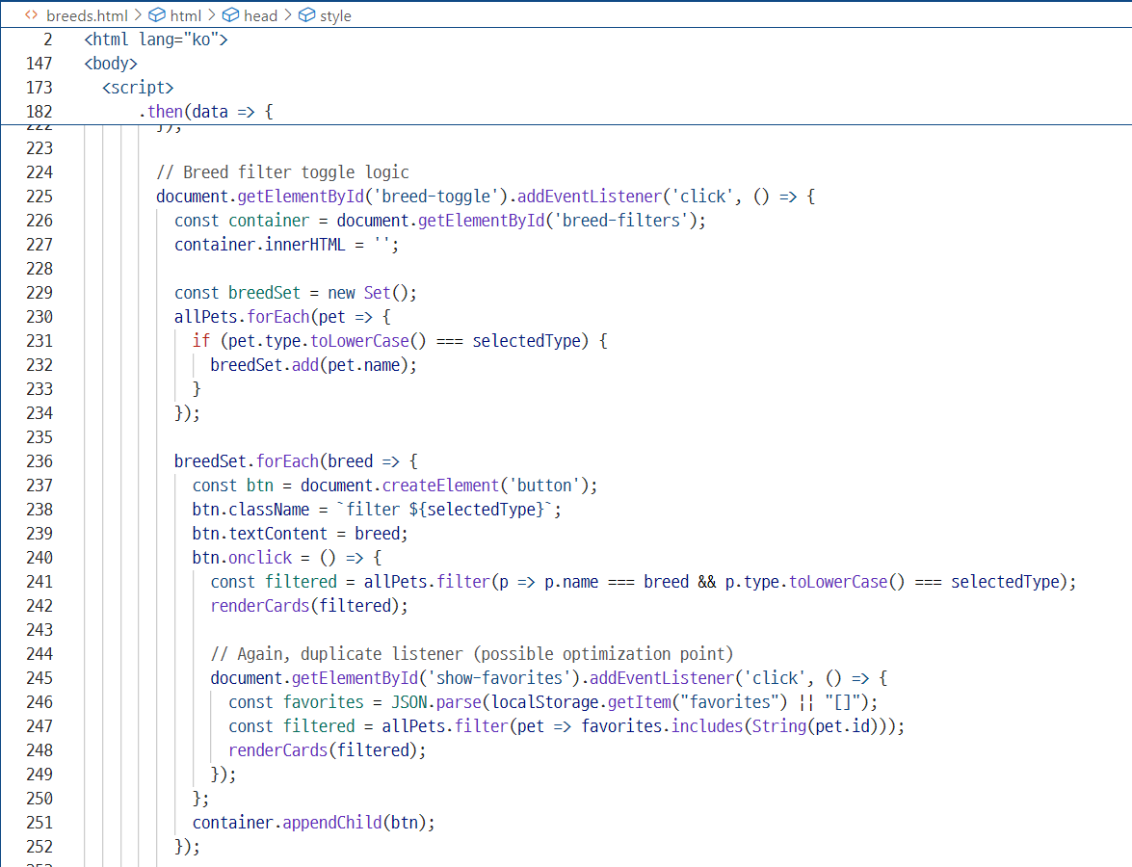
breeds.html– Code Snippet

Slide 26
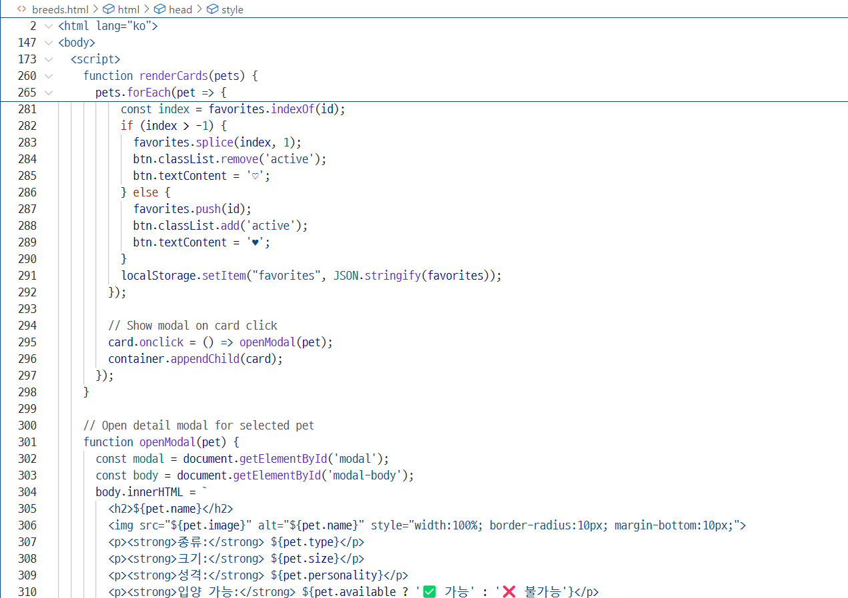
breeds.html– Code Snippet

Slide 27
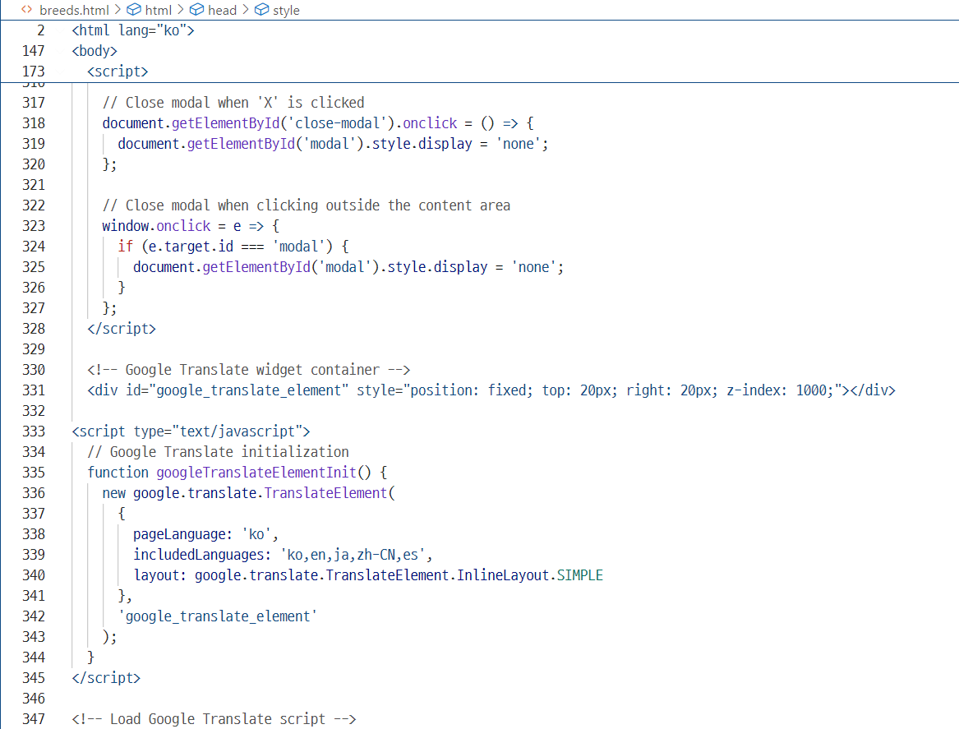
breeds.html– Code Snippet

Slide 28
Index.html
This defines the homepage layout with two adoption buttons.Structure:
<head>: title, inline styles, responsive meta tag
<body>: full-screen centered layout with FlexboxKey Features:
Two buttons styled as cards: - "Adopt a Dog" → links to breeds.html with type=dog - "Adopt a Cat" → links to breeds.html with type=cat
Uses soft background colors and hover animation- Clean, minimal design for simple navigation
A full-screen, centered homepage that lets users choose between dog or cat adoption.
.

Slide 29
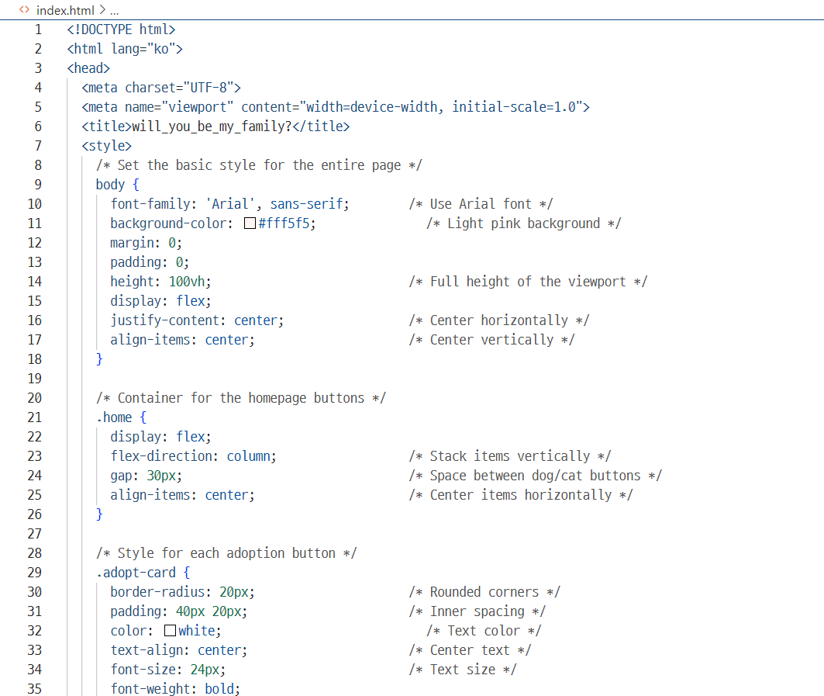
index.html– Code Snippet

Slide 30
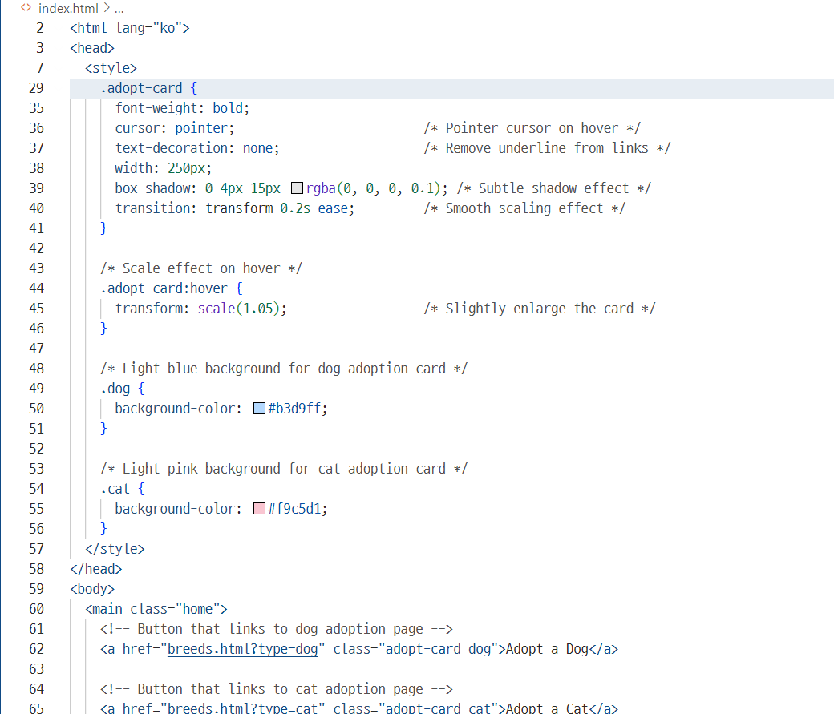
index.html– Code Snippet

Slide 31
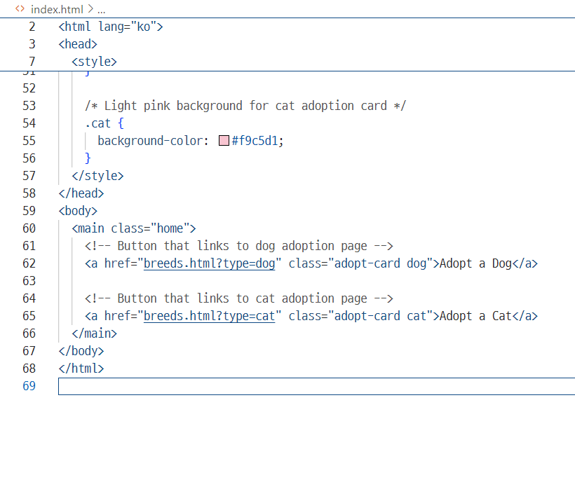
index.html– Code Snippet

Slide 32
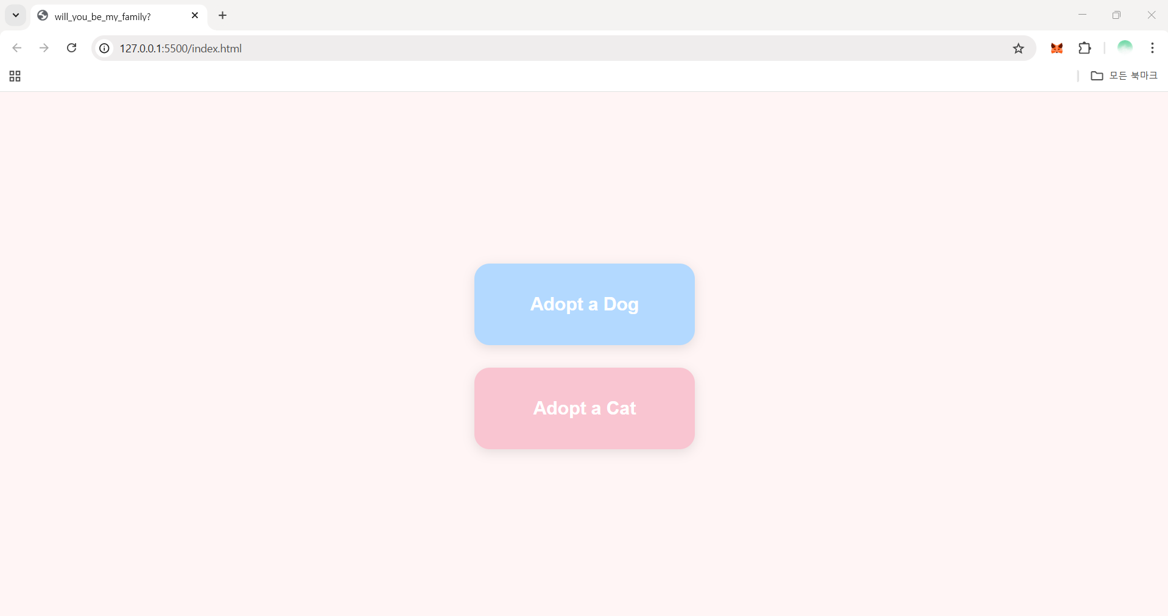
Design-first page of website

Slide 33
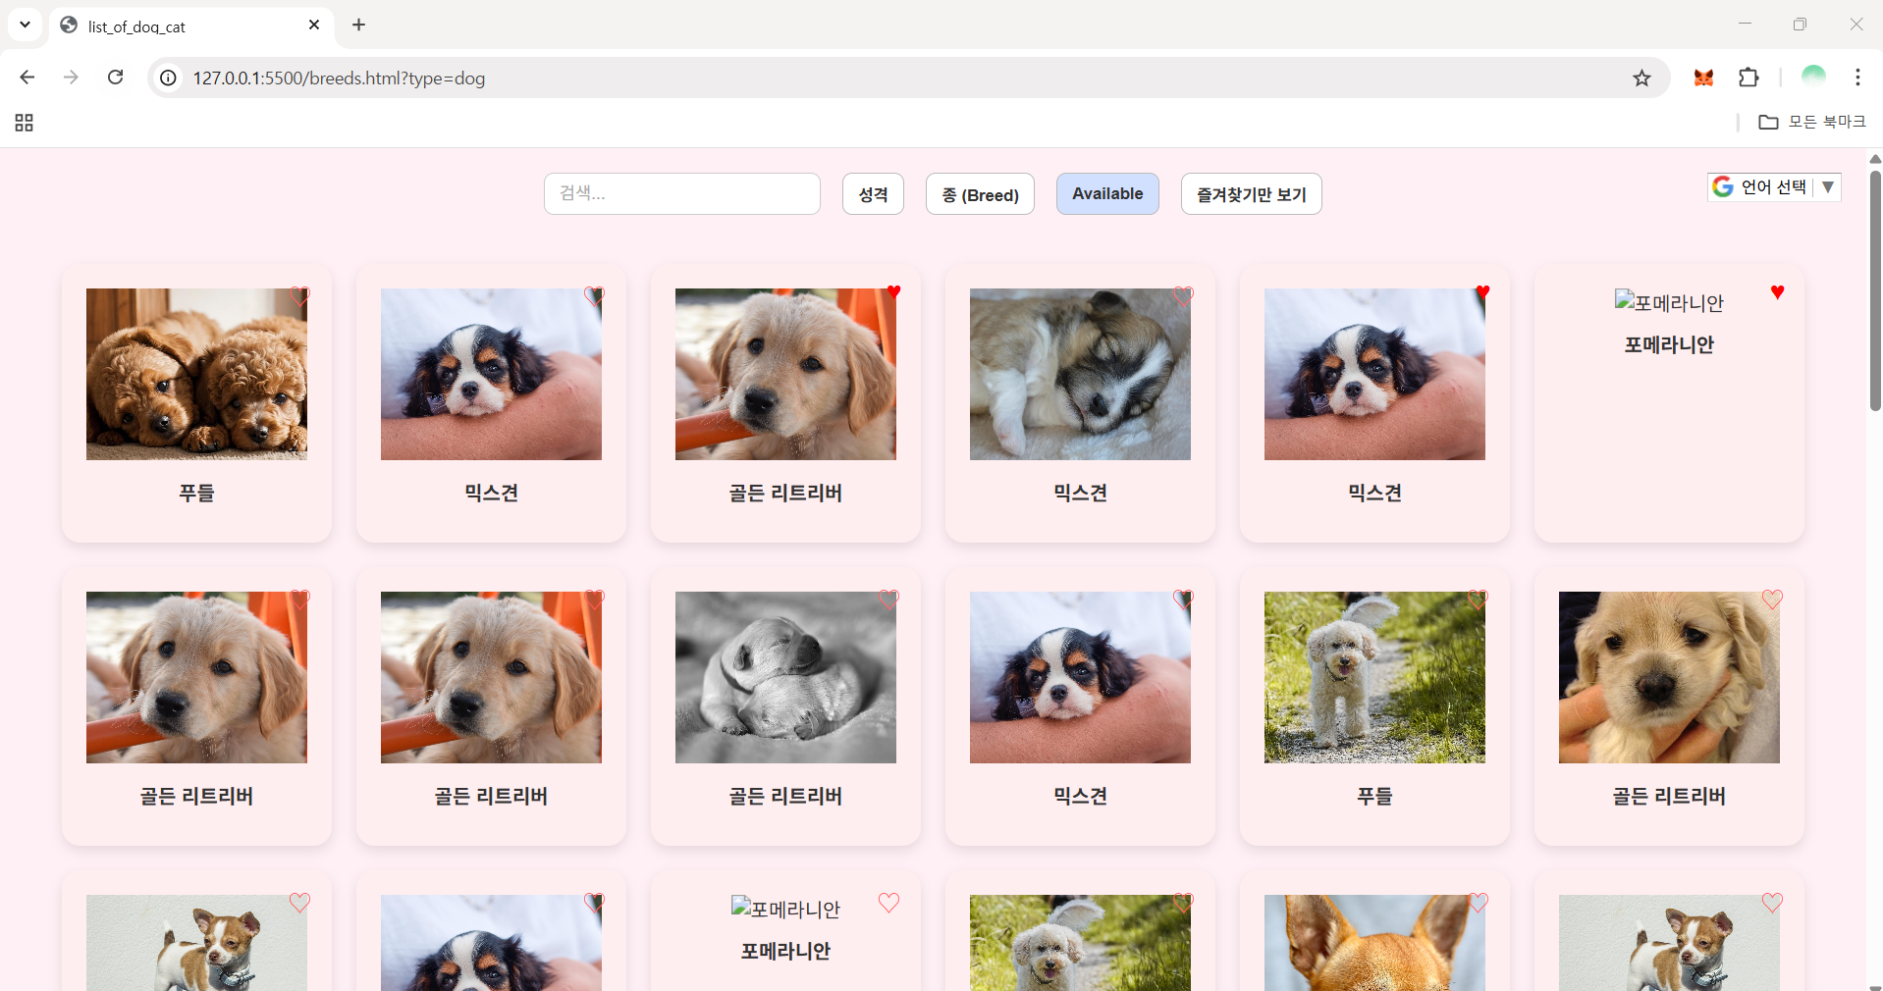
Website home

Slide 34
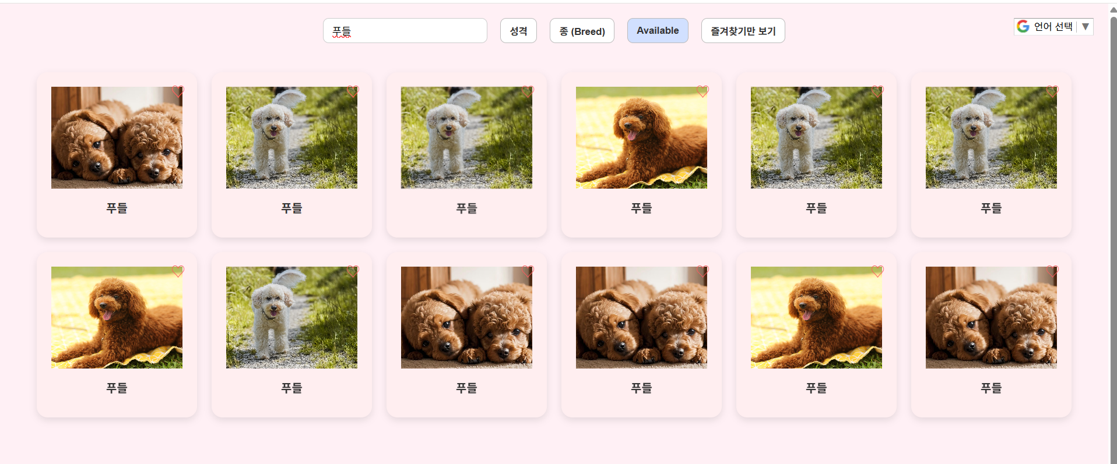
Search page

Slide 35
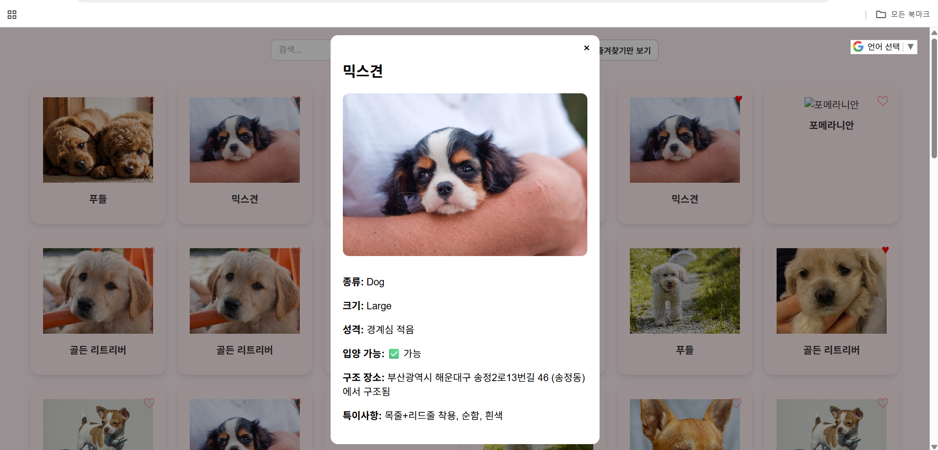
Detail page

Slide 36
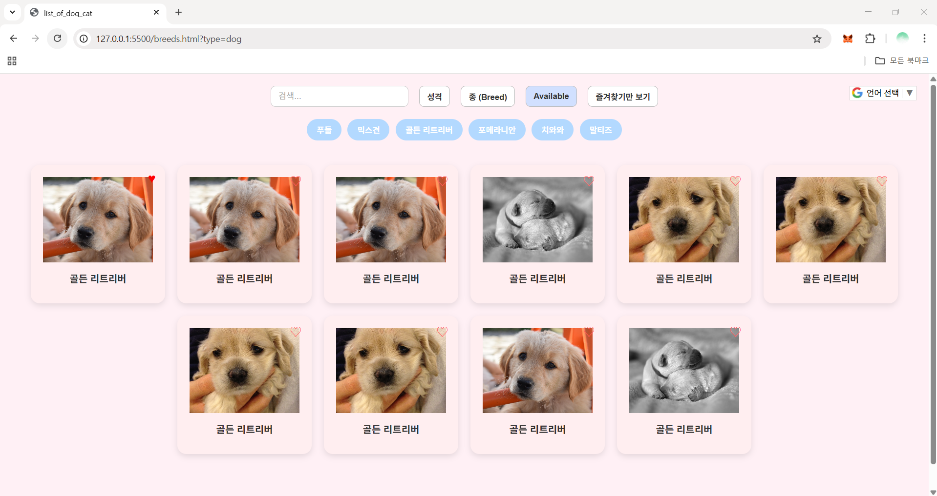
Breed filter

Slide 37
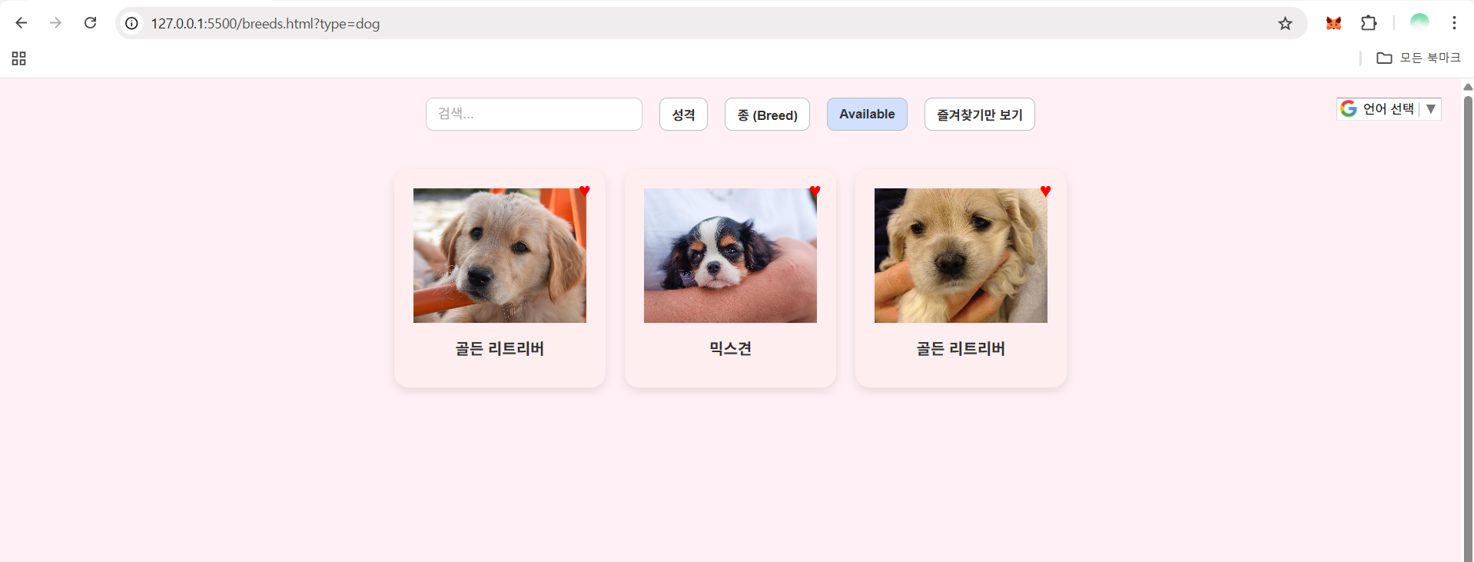
Like function

Slide 38
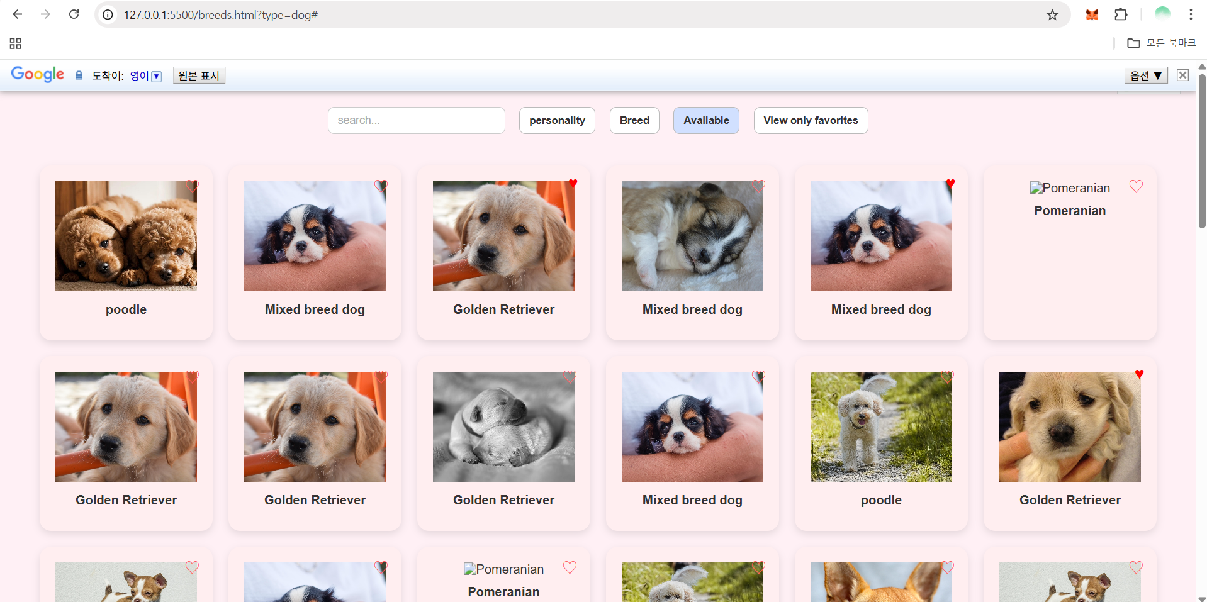
Translate function

Slide 39
Things to improve
The images are vertically too large, making it difficult to view details → Will resize them appropriately
.Will add images of a Pomeranian and a cat.
The heart icon for favorites will be resized to appear larger.
Will add Google Maps to show the shelter location of each animal.
Add downloading adoption application form function
Will refine personality classification using two aspects
Activity level: Active / Calm, Guardedness: High / Low

Slide 40
Things to improve
On the main page,will add the site title "Will you be my family?" in a speech bubble from an animal, and include the site’s purpose above or below the "Adopt a Dog / Cat" cards.
Will change the background color of the filter (search) page to gray,while keeping the card colors unchanged.
Will improve the design details of the buttons and the search bar for better visual quality. Fixed an issue where clicking a breed button keeps it active even after another button is selected →Will fix it using token-based logic or improved state management
Currently, English keyword search doesn’t work properly →Will modify the logic to support English search (case-insensitive).

